Slide 1

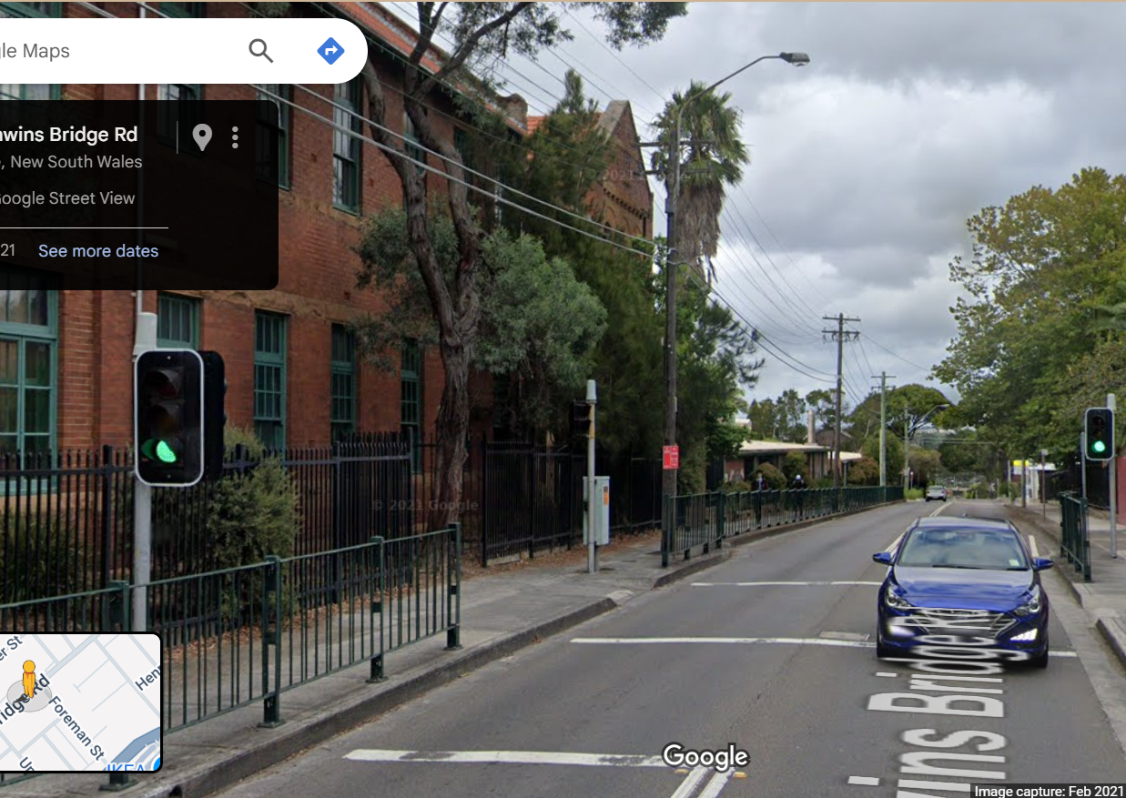
Pi Pico OOP Mini Project
Ben Jones
Tempe High School
Lecture 1
Notes:
This lecture focuses on the fundamental concepts
Of the Object Oriented Paradigm

Slide 2
Today
Unit Testing
UML (Unified Modelling Language)
Generalisation
Bottom up
Super/Sub Class
Pin & PWM Super Classes
Instantiation
Inheritance
Notes:
Today we will cover
Unit Testing
UML (Unified Modelling Language) diagrams
Learn about Generalisation
Apply Bottom-up approach to OOP
Learn about Super/Sub Class relationship
Also called the Parent/Child
Introduce the Pin & PWM Super Classes
Learn about Instantiation
Learn about Inheritance

Slide 3
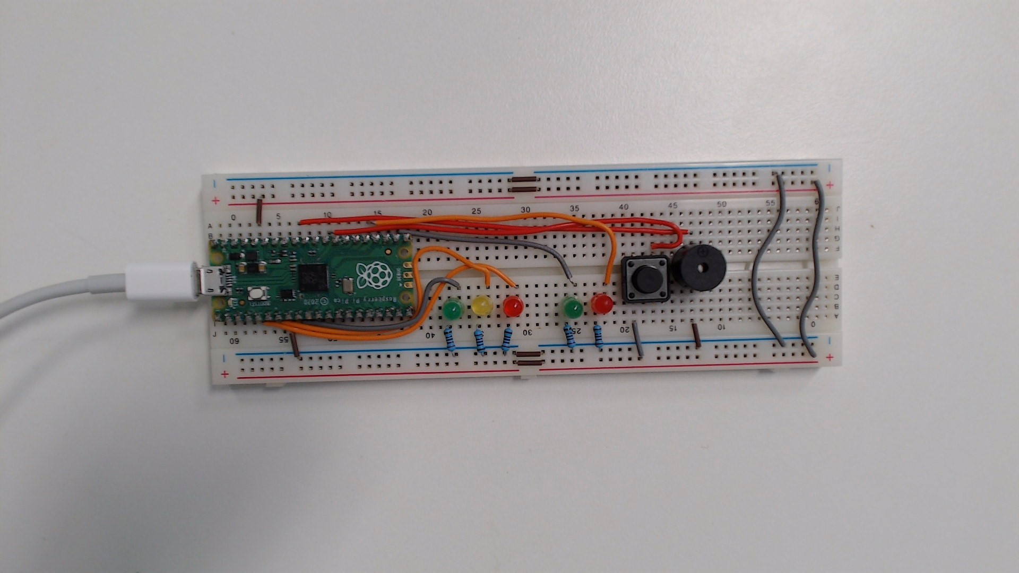
Unit Testing
Testing method where individual components are tested in isolation to verify their correctness.
By ensuring each component works independently, you can confidently build more complex mechatronic solutions.
Classes
Functions or methods
Components
Wires
Wiring
Notes:
Unit Testing is a an approach to testing where individual components are
tested in isolation to verify their functioning as expected.
By ensuring each component works independently,
you can build more complex mechatronic solutions.

Slide 4
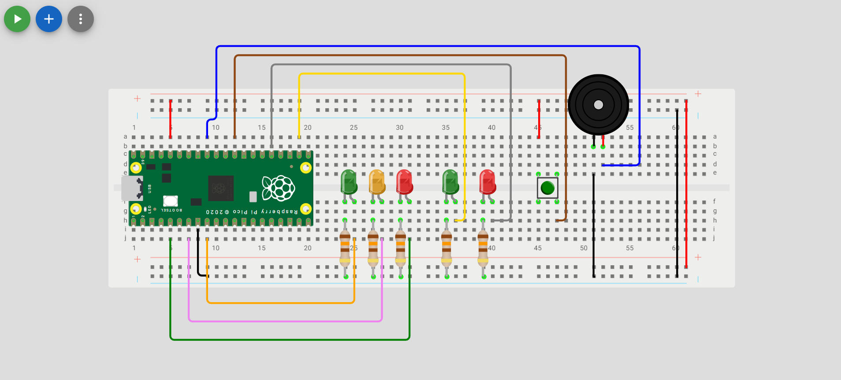
Wokwi Prototype
Unit Tests
All 5 LEDs should illuminate.
The buzzer should emit animated musical note on screen and if volume is turned up a constant tone.
The momentary switch should return `1` to the IDE terminal when closed (pressed) and 0 when not closed (depressed).
Hardware unit test is v02.py
Notes:
Use the code in v02.py to unit test your Wokwi prototype
The outcome of your test should be
All 5 LED’s illuminate
The buzzer beeps
The buttons returns 1 to the terminal when pressed

Slide 5
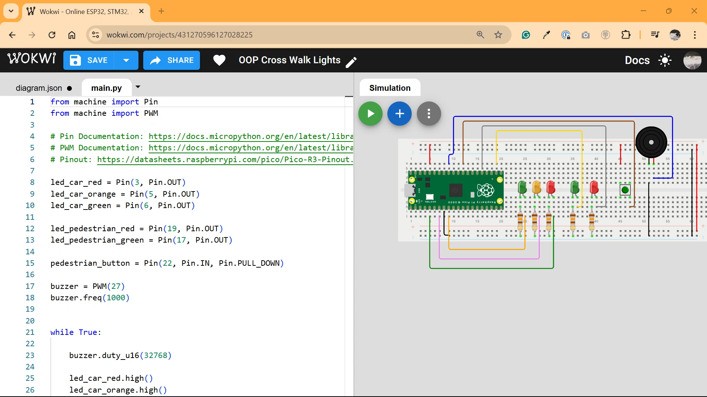

Slide 6

Physical Prototype
Unit Tests
All 5 LEDs should illuminate.
The buzzer should emit a constant tone.
The momentary switch should return `1` to the IDE terminal when closed (pressed) and 0 when not closed (depressed).
Hardware unit test is v02.py
Notes:
Use the code in v02.py to unit test your physical breadboard
In VSCode run the script ‘run current file on pico’
The outcome of your test should be
All 5 LED’s illuminate
The buzzer beeps
The buttons returns 1 to the terminal when pressed

Slide 7
Video of physical unit test

Slide 8
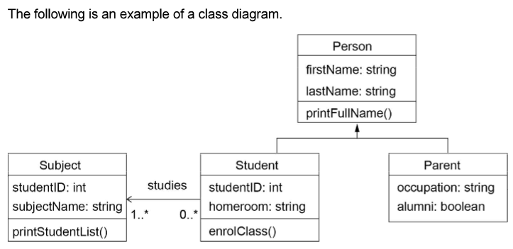
UML
Class Name (Top Section): This is the uppermost part of the box. It displays the name of the class (e.g., Student, Order, Car).
Attributes (Middle Section): This section lists the attributes (or properties/fields) of the class. Each attribute is typically shown with its visibility (+ for public, - for private, # for protected), name, and type.
Methods (Bottom Section): This section lists the methods (or operations/functions) that belong to the class. Each method is shown with its visibility, name, parameters, and return type.
Connections (lines and arrows): These lines and arrows represent relationships (such as inheritance, association, aggregation, and composition) between class boxes.
Notes:
We model Classes & Class relationships using UML diagrams
The diagram in the right is from the course specifications
The requirements in this course for UML are
Clearly written in the course specifications
You should be very familiar with the requirements
And the specification
The top box is the Class name
In the middle box are the attributes of the Class, including their type
In the bottom box are the methods
The connecting lines and arrows represent the relationship
Either inheritance or association, which we will
Learn about and apply in the project over the next few lectures

Slide 9
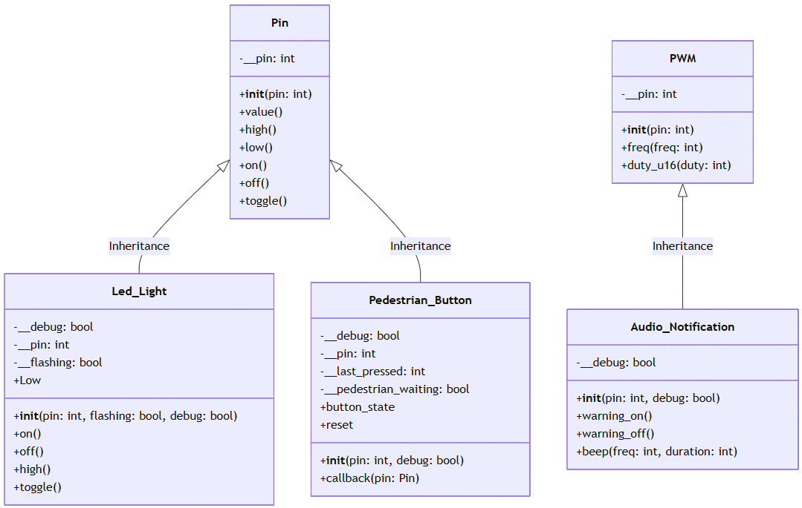
Generalisation
The process of identifying patterns or commonalities among specific examples or cases and formulating a broad class that can be applied to all instances.
On the Pi Pico, the Pin and PWM libraries are designed generalised providing a flexible and reusable interfaces for interacting with the microcontroller’s hardware. The simple on(), off() or high(), low() methods are not specific to any hardware but are generalised to the nature of a digital GPIO Pin.
Notes:
Generalisation in object-oriented programming
means creating a broad, general Class that captures
shared features or behaviour, so that more specific Classes
can inherit from it.
On the Pi Pico, the Pin and PWM libraries are generalized
providing a flexible and reusable interfaces for interacting
with the microcontroller’s hardware.
The simple on(), off() or high(), low() methods are not specific
to any hardware but are generalised to the nature of a digital GPIO Pin.

Slide 10
Super/Sub Class
The Super Class defines common attributes and methods that can be shared by its Sub Classes, promoting code reuse and organisation.
The Sub Class inherits (a concept we will next cover) the generalised Super Class and extends it, providing more specific functionality.
In MicroPython Super Classes Pin & PWM are more the most generalised classes which define common attributes and methods that will be used by the less generalised Sub Classes that we will implement.
Notes:
The terms Super/Sub or Parent/Child refer to the
Descending relationship of Classes.
The Super Class is more generalised,
The Sub Class inherits behaviours from the Super Class and then extends them
or makes them specialised for a specific design problem or hardware.
It’s important to know Parent/Child or Super/Sub are
interchangeable terms, but they are always paired together.
We don’t say parent/sub or Super/Child.

Slide 11
Bottom Up Development
A common development pattern in OOP, the ‘Bottom up’ approach, which involves developing the generalised Super Classes first. Then, developing the more specific Sub Classes up towards the full system. When you are looking at UML diagrams, the bottom is actually the top of the diagram.
Notes:
A common development pattern in OOP,
the ‘Bottom up’ approach, which involves developing
the generalised Super Classes first.
Then, developing the more specific Sub Classes working
towards the full system. When you are looking at
UML diagrams, the bottom is actually the top of the diagram.
We will use the Bottom-up approach for this task
and it is generally the preferred approach for
Object oriented programming

Slide 12
Super Class Documentation
Machine.Pin Library Documentation
Machine.PWM Library Documentation
The Pin library in MicroPython for the Pi Pico allows you to control the General Purpose Input/Output (GPIO) pins of the Pico. It allows you to configure pins as digital (binary) inputs or outputs.
The PWM Library provides an interface for controlling PWM signals on a specified GPIO pin. It allows you to configure any GPIO pin as a PWM and set the duty cycle and frequency.
Notes:
In this project we will use the generalised
Classes Pin and PWM.
Let’s look at the documentation for both of them.

Slide 13
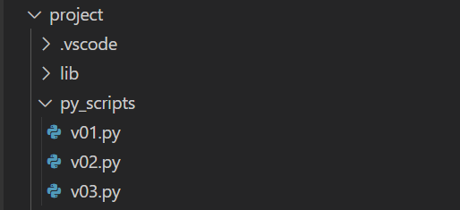
Create a v03.py in project\py_scripts\
We will use this py_script to demonstrate some core OOP principles and then develop our first more specific Sub Class for a led light in our traffic light controller.
Notes:
Create v03 .py in py scripts where you will
Instantiate some instances of the Pin Class.

Slide 14
Instantiation
Instantiation is a fundamental concept in object-oriented programming (OOP). A class is like a blueprint for an object, it defines the attributes and methods the object will have, but it isn’t an actual object itself.
Instantiation is the process of creating a copy of the class structure that will be a real, usable object in memory.
Notes:
Instantiation is the process of using the
Class to create a real, usable object in memory.
It creates a namespace for the copy of the
Class so that the attributes and methods
Of the instance can be accessed.

Slide 15

Instantiation
from machine import Pin
from time import sleep
led_car_red = Pin(3, Pin.OUT)
led_car_orange = Pin(5, Pin.OUT)
led_car_green = Pin(6, Pin.OUT)
while True:
led_car_red.toggle()
led_car_orange.toggle()
led_car_green.toggle()
sleep(1)
Notes:
Pause this video and code this implementation in v03.py
Next I will demonstrate how to execute
Your code on the Pi Pico.

Slide 17
Inheritance
Inheritance is a fundamental concept in object-oriented programming (OOP). It allows a class (called Sub Class) to inherit properties and behaviours (methods and attributes) from another class (called a Super Class).
In this case, the Led_Light Class inherits the Pin Class, and without any further instructions, the Sub Class inherits and can call all the methods of the Super Class, including on(), off(), high(), low(), toggle(), etc.
Notes:
Inheritance is the Sub Class inheriting
the attributes and methods of the Super Class.
In this case, the Led_Light Class inherits the
Pin Class, and without any further code
The methods of the Super Class, including
on(), off(), high(), low(), toggle(), etc can
Be called by the Sub Class name space.
It’s important to understand a copy of the Super
Class is made into memory. From instantiation forward
It is the copy in the new namespace that is modified
The Base Class blueprint remains static.

Slide 18
Inheritance
from machine import Pin
from time import sleep
class Led_Light(Pin):
def __init__(self, pin):
super().__init__(pin, Pin.OUT)
red_light = Led_Light(3)
while True:
red_light.toggle()
sleep(1)
Notes:
Replace the instantiation code you wrote in v03.py
With this code. We will start our Led_Light Class
And demonstrate inheritence

Slide 19
Notes:
As you can see
We have created a new class call Led_Light
And instantiated an instance to the namespace
Red_light we can then access the toggle method
From the super class without any implementation
In the Led_Light sub class

